Slide 1
PH-107
Quantum Physics and Applications
Elements of Statistical Physics-IV
Black-Body Radiation
Gopal Dixit
gdixit@phy.iitb.ac.in

Slide 2
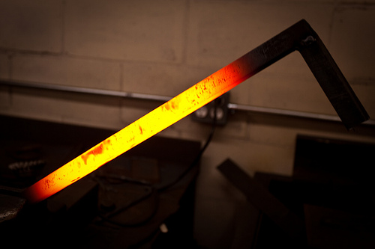
Radiation:
Two questions can be asked…
Why should a (hot) body emit radiation?
How does the intensity of radiation vary with wavelength (at different temperatures)?

Slide 3
Radiation:
Any heated solid emits radiation in a continuous spectrum. Some empirical observations:
The hotter the body the higher the frequency of radiation. (First the body becomes red hot and then becomes white hot).
The frequency of radiation is independent of the object being heated. It depends only on the temperature.
A Universal character of all heated objects

Slide 4
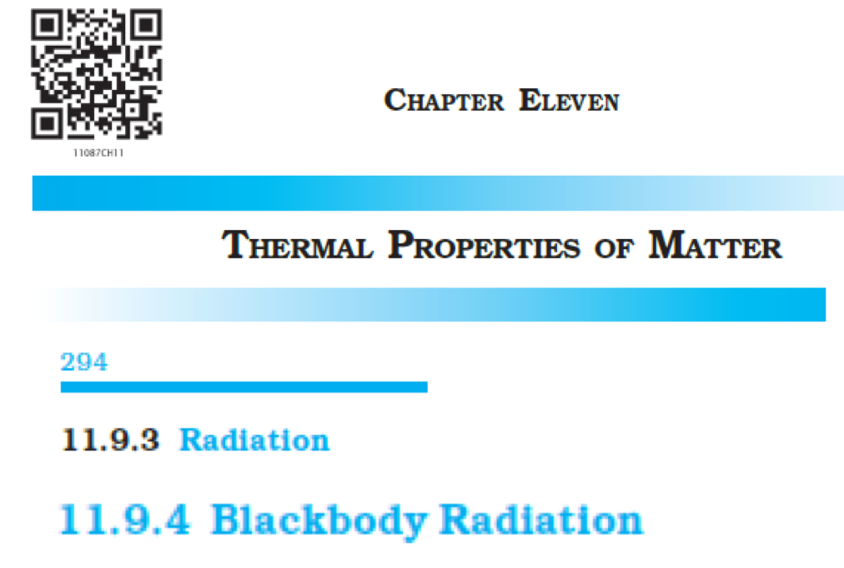
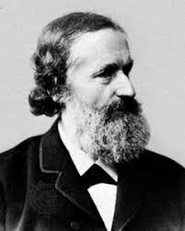
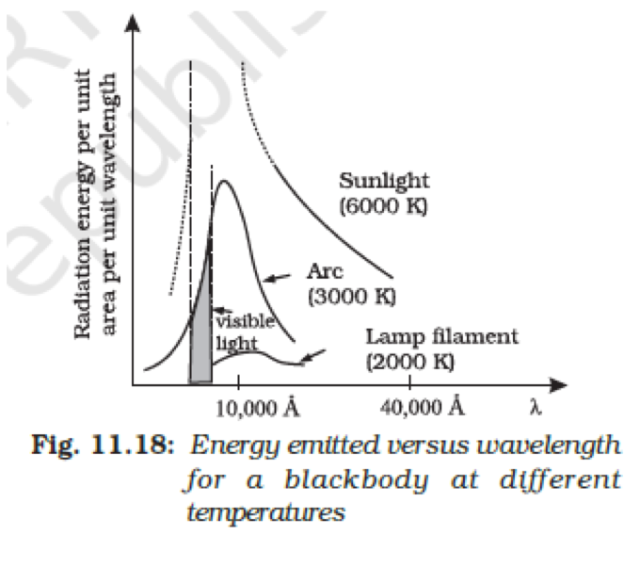
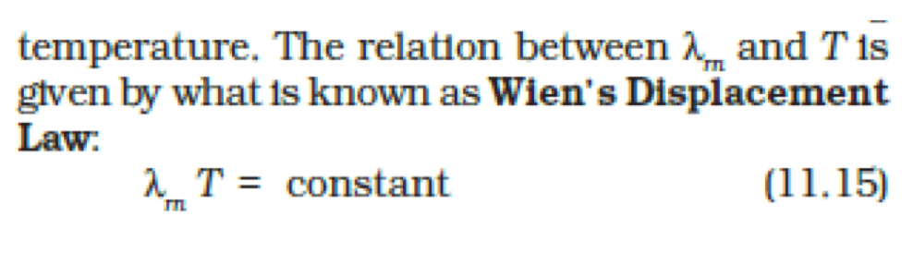
Black-body Radiation (Recap)
Recap from XI class
Gustav Kirchhoff (1824-1887)

Slide 5
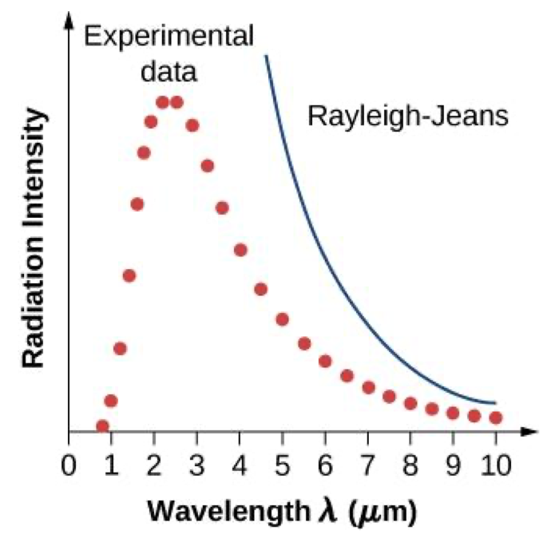
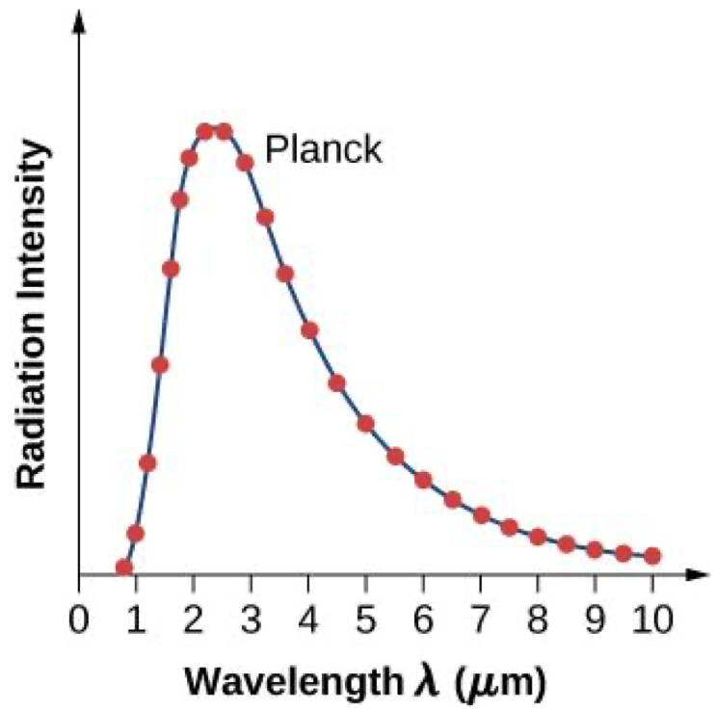


Black-body Radiation (Recap)
Rayleigh–Jeans (1900): “Sources of radiation are atoms in a state of oscillation (classical oscillators)”
Max-Planck (1901): “The elementary oscillators could emit and absorb EM radiation ONLY in discrete packets”
Birth of Quantum Physics !!

Slide 6
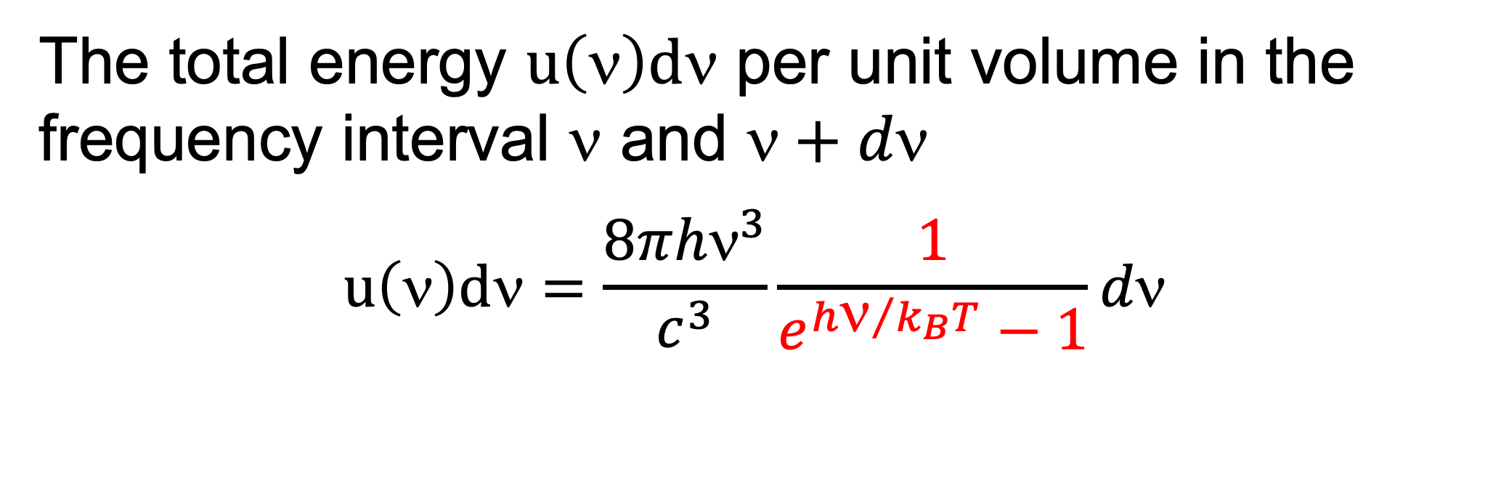
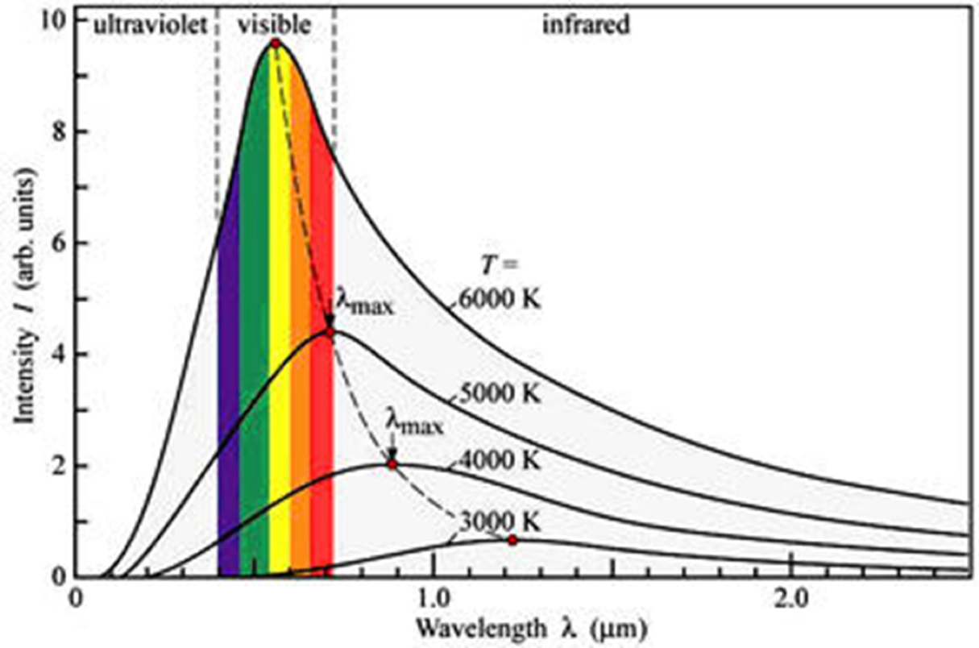
Planck’s Contribution

Slide 7
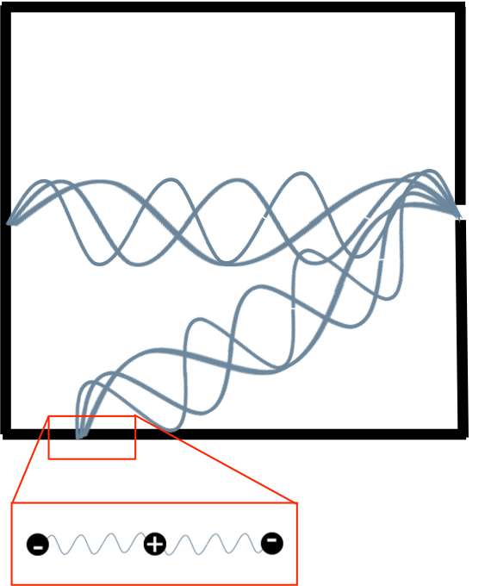
Black-body Radiation
Why should a (hot) body emit radiation?
EM waves are generated by periodically oscillating charges (Maxwell, 1864).
Cavity walls composed of billions of miniscule charged oscillators.

Slide 8
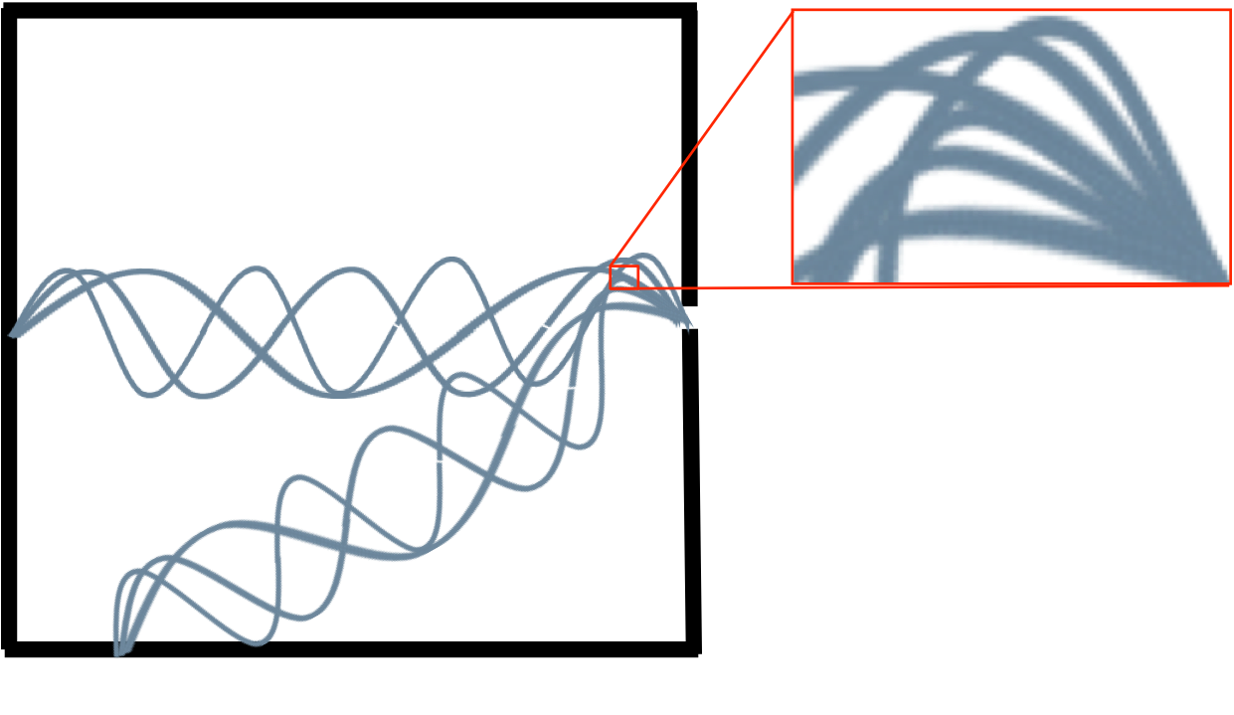
Black-body Radiation
Radiation inside the cavity at absolute temperature T are a series of standing EM waves.
How many standing waves in the frequency interval v and v+dv?

Slide 9
Black-body Radiation
We model the enclosure heated to temperature T as a gas of photons (Bosons).
So, the number of photons within the energy range E and E+dE is given by
and the energy of the particles by
All we need to find is g(E).

Slide 10
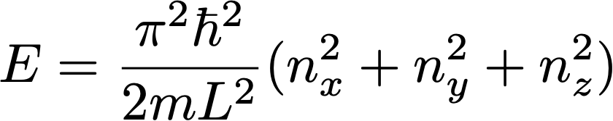
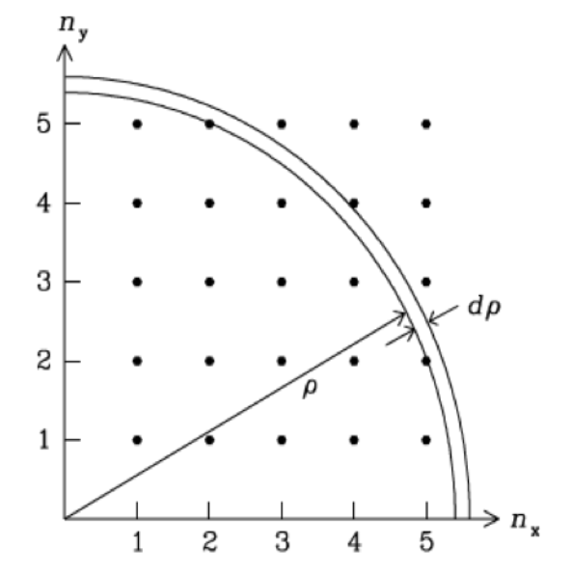
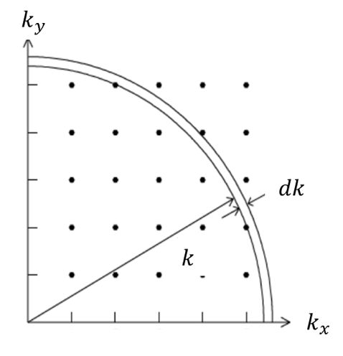
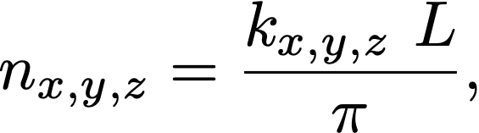
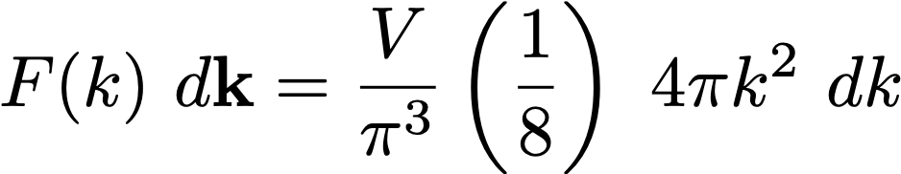
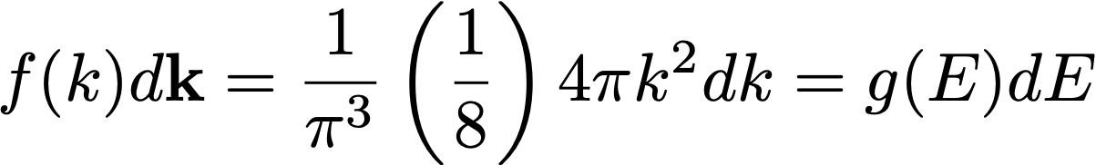
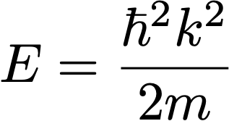
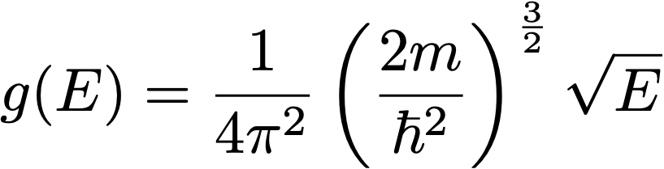
Density of State (Recap)
Let us recap how we estimated density of state g(E) in previous lecture.
We have written the energy as
What is the area (volume) of the 2D (3D) k-space occupied by each point ?
Density of states in the k space

Slide 11


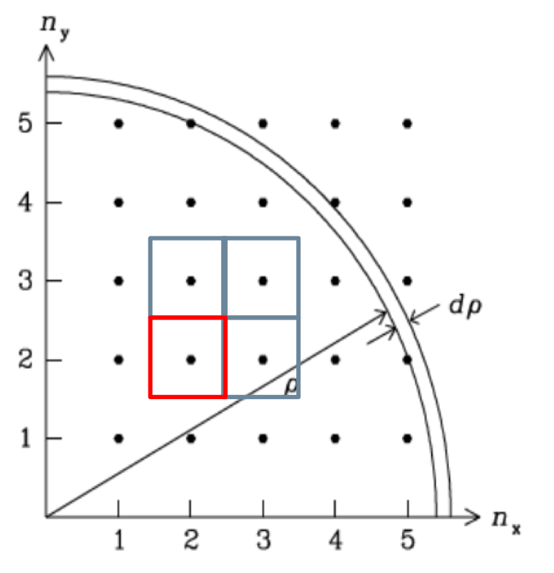

Density of State
Integer space
In integer space, let us calculate the density of states Χ(ρ)
as
could be equated to
How do we get Χ(ρ)?
We know the size of the box enclosing each point is 1×1 (No unit, it’s a number space!)
Density of points in integer space Χ(ρ) = 1

Slide 12
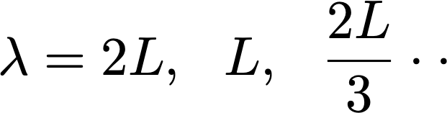
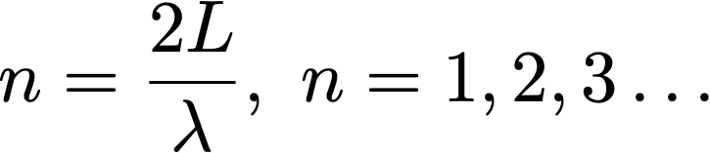
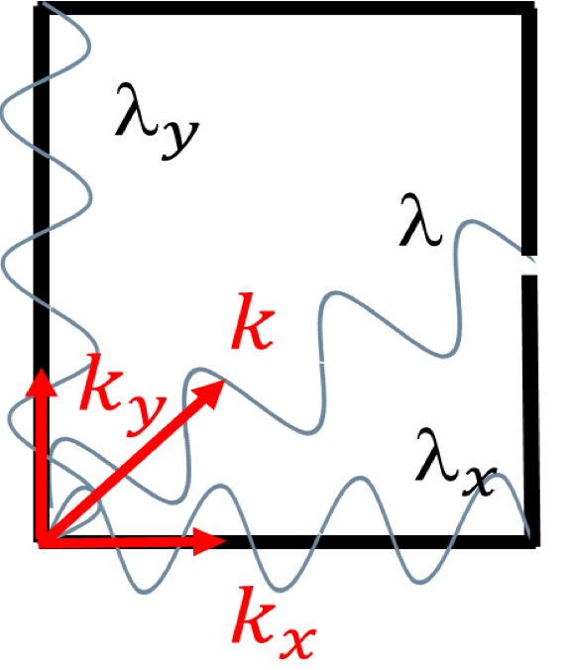
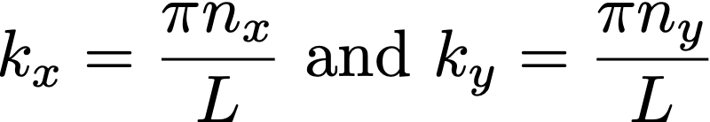
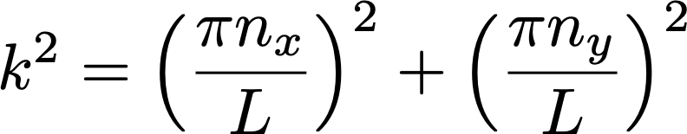
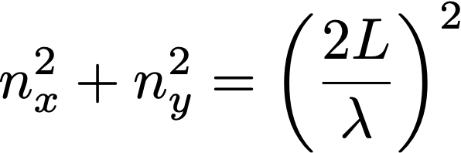
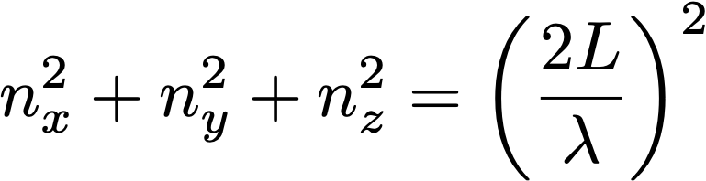
Density of State
For standing waves, nodes at boundary implies
or
For wave in x- and y-directions
The condition above can be written as
or

Slide 13
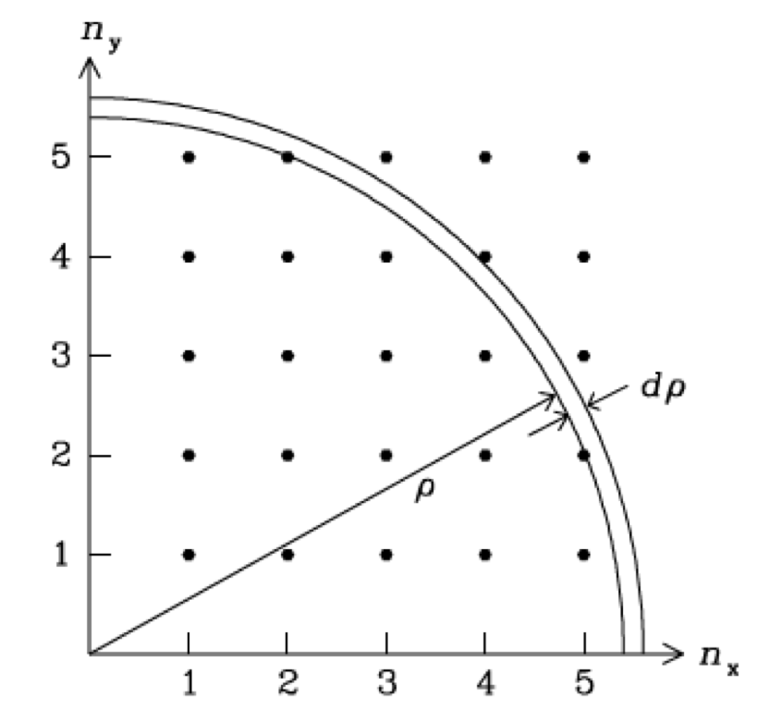
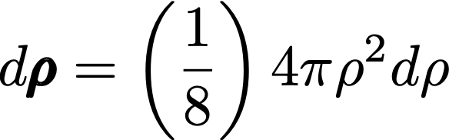


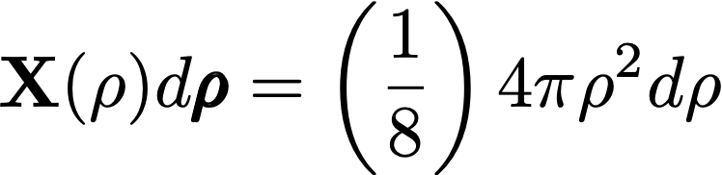
Density of State
Density of states is 1 state per unit volume of the number space
So, number of states between
and
But,

Slide 14
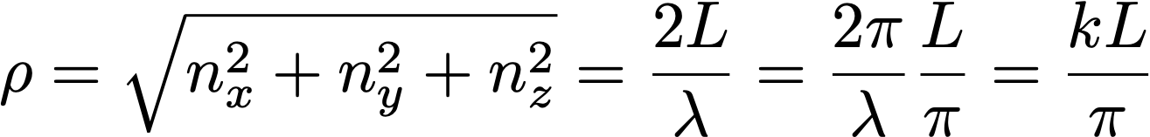
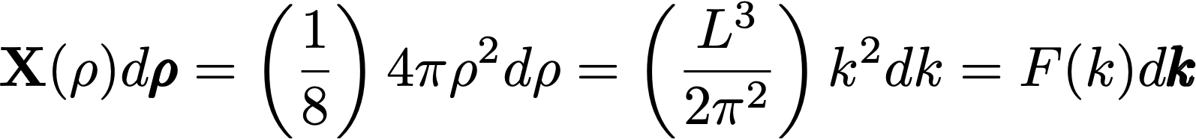
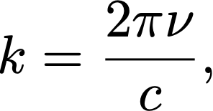

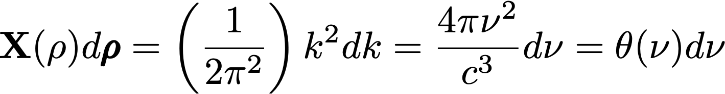
Density of State
Note that
Note that
(the volume of the enclosure) and
we can write

Slide 15
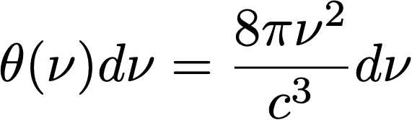
Density of State
BBR spectral Density
Finally, we have to account for the fact that each k-state is 2-fold degenerate due to the two possible polarizations of the E-field for each mode, So we get
Now you can verify

Slide 16
Planck’s Lucky Guess

Slide 17
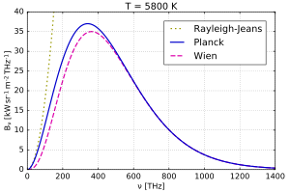
Deduce the results of Rayleigh-Jeans Law and Wien’s Law from Planck’s results.

Slide 18
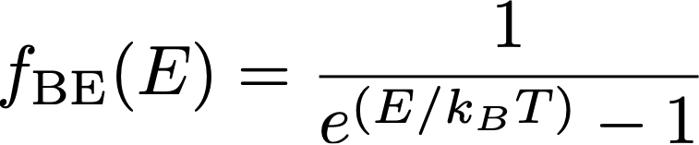
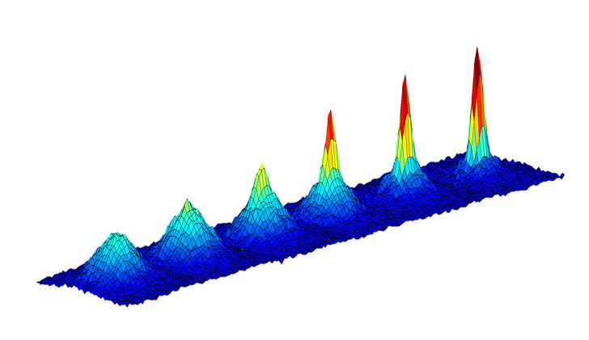

Distribution Function
Case I:
Case II:
Occupation probability of lowest energy states increases exponentially, at sufficiently low temperature, all particles drop down to the ground energy state: Bose-Einstein Condensation

Slide 19
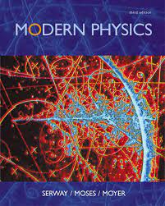
Recommended Readings
Statistical Physics, Chapter 10, Section 10.4

